Slide 1

AI Partner Tech Series - Azure Cognitive Services

Slide 2

About JumpStartNina

Slide 3
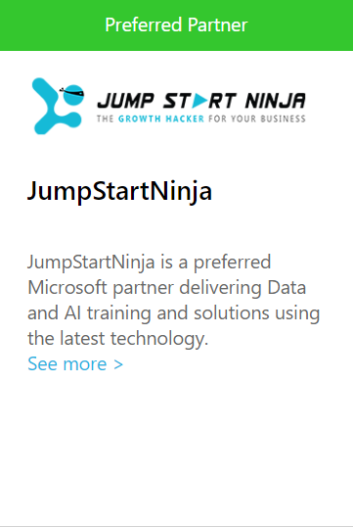

At JumpStartNinja we have an impeccable record of delivering Data, AI, ML, IoT and Blockchain Based Solutions, Workshops & Consulting Assignments, Developing Pilot Projects, Implementation of “Proof Of Concepts".
Microsoft Core Engineering & Business teams Certified our Consulting & Implementation Skills on Data + AI + IoT + Blockchain Workloads.
We have been nominated as the Preferred Partner for Learning and Solution Implementation Activities for all System Integrators of Microsoft

Slide 4
Azure Skill Map
CHALLENGERS
LEADERS
Time Series Insights
Machine Learning
SQL Data warehouse
Azure Bot Framework
Azure IoT
IoT Edge
Azure Cognitive Services
Azure Block Chain
SQL Database
Story Telling with Power BI
ABILITY TO EXECUTE→→→→→→
Azure Data Lake Analytics
Deep Learning
Azure Data Factory
Stream Analytics
Databricks
HD Insight
Azure Cosmos DB
Azure Table Storage
Data Catalog
Azure Data Lake
NICHE PLAYERS
VISIONARIES
DEPTH OF KNOWLEDGE →→→→→→

Slide 5
Our Global Workshops Delivered So Far…
UK
India
Canada
Germany
USA
Australia
Mexico
Singapore
Malaysia

Slide 6












Our Global Clients

Slide 7
Workshops / Training Milestones Achieved
More than 240,000 + Training Hours Delivered
Trained 15000 + Individuals so far
Having 20 + Trainers & Consultants Worldwide
Delivered to 15+ Companies so far
Workshops Delivered in 7 countries
Very Strong
in 5 Azure Workloads

Slide 8

The RISE of AI

Slide 9
The Rise of AI
28 Years Old, Female
Language – English
Sentiment – Neutral
Seen Before – Yes (Voice, Face)
Context – Good Places to Eat
?
?
I would like to order some food
?
?
?
Hey, Good to See you back…
Would you like to checkout the new Italian Restaurant in the city and try out “Pepperoni Pizza” there ?
Search
Sentiment (face, text, voice)
recommendations
Search
Sounds Good, Book It !
Book
Sentiment (face → Happy)
Context – Italian Restaurant Booking
I am Glad that I am able to help you today. Have a good day !

Slide 10
The What, How and Why of Cognitive Services

Slide 11
Azure Cognitive Services are APIs, SDKs, and services provided by Microsoft to help developers build intelligent applications without having direct AI or data science skills or knowledge. Azure Cognitive Services enable developers to easily add cognitive features into their applications.
A set of Machine Learning Algorithms bundled and provided as simple RESTful APIs hiding all the complexities behind the scene
The goal of Azure Cognitive Services is to help developers create applications that can see, hear, speak, understand, and even begin to reason.
It’s a way to quickly build “Eyes and Ears” to your applications !!

Slide 12
Working with Cognitive Services in SILOs is very simple and easy. You just need to know what is the API/SDK, what are the input parameters to be passed and what is output JSON structure…
But the complexity lies in
When to pick which API / SDK ?
How to integrate Many Cognitive Service API together to build an End-to-End use-case ?
What are the best practices associated with each APIs ?
What are the limitations and work-arounds for the same.

Slide 13
Data to Wisdom Pyramid
Wisdom
Applied
I better stop my car !
Knowledge
Context
Traffic Light that I am driving toward has just turned Red
Information
Meaning
North Facing Traffic Light is on. George + Pitt Strert Jn
Data
Raw
Red, 192.222.234.234, Lat:, Lon :
“Artificial Intelligence” provide best & desirable results when they are applied at the top two layers of
solution landscape / lifecycle
If they are applied without having adequate Data + Information its called as ”Natural Stupidity”

Slide 14
Cortana Intelligence Suite | Overview
Information Management
Big Data Stores
Machine Learning and Analytics
Intelligence
Data Sources
People
Data Factory
Data Lake Store
Machine Learning
Cognitive Services
Data Catalog
SQL Data
Warehouse
Data Lake Analytics
Bot Framework
Web
Apps
HDInsight
(Hadoop and Spark)
Event Hubs
Cortana
Mobile
Apps
Stream Analytics
Bots
Dashboards & Visualizations
Sensors and devices
Power BI
Automated Systems
Data
Intelligence
Action
Notes:
Cortana Intelligence Suite delivers an end-to-end platform with integrated and comprehensive set of tools and services to help you build intelligent applications that let you easily take advantage of Advanced Intelligence.
First Cortana Intelligence Suite provides services to bring data in, so that you can analyze it. It provides information management capabilities like Azure Data Factory so that you can pull data from any source (relational DB like SQL or non-relational ones like your Hadoop cluster) in an automated and scheduled way, while performing the necessary data transforms (like setting certain data columns as dates vs. currency etc.). Think ETL (Extract, Transform, Load) in the cloud. Event hub does the same for IoT type ingestion of data that streams in from lots of end points.
The data brought in then can be persisted in flexible big data storage services like Data Lake and Azure SQL DW.
You can then use a wide range of analytics services from Azure ML to Azure HDInsight to Azure Stream Analytics to analyze the data that are stored in the big data storage. This means you can create analytics services and models specific to your business need (say real time demand forecasting).
The resultant analytics services and models created by taking these steps can then be surfaced as interactive dashboards and visualizations via Power BI
These same analytics services and models created can also be integrated into various different UI (web apps or mobile apps or rich client apps) as well as via integrations with Cortana, so end users can naturally interact with them via speech etc., and so that end users can get proactively be notified by Cortana if the analytics model finds a new anomaly (unusual growth in certain product purchases- in the case of real time demand forecasting example given above) or whatever deserves the attention of the business users.

Slide 15
Cognitive Services | Most Popular Use Cases
Retail
Consumer Centric
User Demographics Identification
In-Store User Behavior and Just In Time Deals
Billing / Payment Queue Optimization
In Store Voice Based Guiding Assistant
Smart Mirror – Helps in Choosing the Size, Color and Shape before trying out in Trial Rooms
Visual Search – Online Retail Market
Retail Outlet Centric
Billing Counter Optimization
Conversion Calculation and Daily / Weekly Trend Analysis
Planogram Compliance Check and Effective Merchandizing
Identification of Events as they occur using CCTV streaming
Employee Check in / Check out
Shoplifting Incidents and registering the faces against such events

Slide 16
Cognitive Services | Most Popular Use Cases
2. Quality Control
Automation of Assembly Line Quality Control
3. Health Care / Home Care
Detection of Fall and Timely Support
Understanding Patient’s Pain Level using Facial Sentiments
4. Facial Recognition Systems – Across Domains
5. Public Safety
Automatic Extraction of Events from Video Feeds – Like Fire Accidents, Mob Attacks, Murdering Intent,
Chain Snatching, Violation of Traffic Rules and so many.
6. RPA & Conversational Commerce
7. Building Voice / Gesture Based Digital Assistants

Slide 17
Our Success Stories with Cognitive Services …
Client : Very Large FMCG Company
Business Case : Empowering their Sales Force Team to onboard new Shops / Departmental Stores and Increase the Sales of their branded Products
Problems Faced :
Sales People are always “On The GO” and they are not really interested in authentication that works with “Username/password”. They hate using the keyboard on mobile devices
On boarding any new shop is cumbersome as you have Key in so many details
Many a times, product sale is not up to the mark due to merchandising problems. Though the shop owners are provided with the Planogram they hardly follow. And the current Planogram Compliance Check is Manual and time consuming process
Cognitive Services used to solve the Problems
Face API
Computer Vision – OCR
LUIS – Azure Based NLP Layer
Custom Vision

Slide 18
Our Success Stories with Cognitive Services …
Client : One of the Largest Consumer Banks in India
Business Case : Enabling Facial Authentical as 3 Factor Authentication
Cognitive Services used to solve the Problems
Face API
Computer Vision – OCR
Custom Vision
JSN’s Custom Built Face Liveliness Detection Module

Slide 19
Our Success Stories with Cognitive Services …
Client : One of the Biggest Logistics Company
Business Case : Automation of Quality Control
Cognitive Services used to solve the Problems
Computer Vision – Analyze Image
Custom Vision

Slide 20
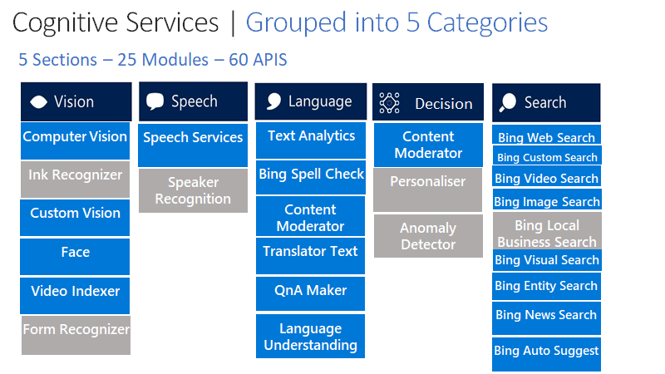





Cognitive Services | Grouped into 5 Categories
5 Sections – 25 Modules – 60 APIS
Decision
Computer Vision
Speech Services
Text Analytics
Content Moderator
Bing Web Search
Bing Custom Search
Ink Recognizer
Bing Spell Check
Bing Video Search
Speaker Recognition
Personaliser
Bing Image Search
Custom Vision
Content Moderator
Anomaly Detector
Bing Local Business Search
Face
Translator Text
Bing Visual Search
Video Indexer
QnA Maker
Bing Entity Search
Bing News Search
Form Recognizer
Language Understanding
Bing Auto Suggest
Notes:
Cortana Intelligence Suite delivers an end-to-end platform with integrated and comprehensive set of tools and services to help you build intelligent applications that let you easily take advantage of Advanced Intelligence.
First Cortana Intelligence Suite provides services to bring data in, so that you can analyze it. It provides information management capabilities like Azure Data Factory so that you can pull data from any source (relational DB like SQL or non-relational ones like your Hadoop cluster) in an automated and scheduled way, while performing the necessary data transforms (like setting certain data columns as dates vs. currency etc.). Think ETL (Extract, Transform, Load) in the cloud. Event hub does the same for IoT type ingestion of data that streams in from lots of end points.
The data brought in then can be persisted in flexible big data storage services like Data Lake and Azure SQL DW.
You can then use a wide range of analytics services from Azure ML to Azure HDInsight to Azure Stream Analytics to analyze the data that are stored in the big data storage. This means you can create analytics services and models specific to your business need (say real time demand forecasting).
The resultant analytics services and models created by taking these steps can then be surfaced as interactive dashboards and visualizations via Power BI
These same analytics services and models created can also be integrated into various different UI (web apps or mobile apps or rich client apps) as well as via integrations with Cortana, so end users can naturally interact with them via speech etc., and so that end users can get proactively be notified by Cortana if the analytics model finds a new anomaly (unusual growth in certain product purchases- in the case of real time demand forecasting example given above) or whatever deserves the attention of the business users.

Slide 21
Vision |Computer Vision
Vision APIs make it possible for apps and services to accurately identify and analyse content within images and videos.
1. Computer vision - Extracts the visual content found in an image . It has the following mostly used APIs
a) Analyze Image
Analyzing Images for insights on the following features
Tag Visual Features, Detect objects, Detect brands, Categorize an image, Describe an image, Detect Faces, Detect image types, Detect domain specific content, Detect the colour scheme, Generate a thumbnail, Get the Area of interest
Moderate content in images – Detects adult and racy content
b) OCR– Extract Text From Images
.

Slide 22
Vision |Computer Vision
APIs Request / Response
https://azure.microsoft.com/en-in/services/cognitive-services/computer-vision/
.

Slide 23
Vision| Computer Vision
Demos
1. User Demographics
2. Analyze Image
3. Categorize and Description Image
4. Face Authentication
5. Face Authentication With OCR
6. Area of Interest
.

Slide 24
Vision|Computer Vision
Use Cases
.
Participants / Customers Demographics Identification
Participants / Customers Facial Sentiments Identification
Image Validation Scenarios – Using Describe Image, Tags and Detect Faces
Printed / Hand Written Documents Reading Scenarios

Slide 25
Vision|Computer Vision
Image Requirements / Limitations / Challenges
.
The image must be presented in JPEG, PNG, GIF, or BMP format
The file size of the image must be less than 4 megabytes (MB)
The dimensions of the image must be greater than 50 x 50 pixels. Esp For better results using OCR, the dimensions of the image must be between 50 x 50 and 4200 x 4200 pixels
On Prem Support is provided for OCR feature of Computer Vision API. You can run this API on container and extract text
OCR is not yet optimized for License Plate Reading Use Cases. While Microsoft team is continuously working to improve the same.
While doing Handwritten OCR, crossed over texts are still identified as valid text. Crossed lines are considered just as noise. If you want them to be ignored, you need to put several crossed lines on the text so that they can’t be recognized.
Handwritten OCR recognized text that is oriented up to 30 to 40 degrees.
Object Detection and Classification is not yet supported for On Prem / Containers
Age detection using Detect API is not very accurate and consistent yet.

Slide 26
Vision|Computer Vision
Hands on Lab
.

Slide 27
Vision|Custom Vision
Azure Custom Vision is a cognitive service that lets you build, deploy and improve your own image classifiers. An image classifier is an AI service that applies labels (which represent classes) to images, according to their visual characteristics. Unlike the Computer Vision service, Custom Vision allows you to determine the labels to apply.
Custom Vision has two Features
1. Image classification applies one or more labels to an image
2. Object detection is similar, but it also returns the coordinates in the image where the applied label(s) can be found
.

Slide 28
Vision |Custom Vision
https://www.customvision.ai/projects
.

Slide 29
Vision|Custom Vision
Demos
1. Event Extraction Services

Slide 30
Vision| Custom Vision
Use Cases
.
Quality Control Checking
Classification of Events in Video Feeds
Building Gesture Recognition Systems

Slide 31
Vision| Custom Vision
Glossary to Remember…
.
Classifier : Model you build using Custom Vision Service, by using a few training images
Domain : Optimized model that classifier for a specific type of object in your images. Ex: Food, Retail, Landmark
General
Evaluation : Submit any image for evaluation by using the auto-generated https endpoint after the training of the classifier is completed
Iteration : Every time you Train or re-train your classifier, you create a new iteration of your model. We keep several past iterations to allow you to compare your progress over time. You can delete any iteration you no longer find useful. Remember that deleting an iteration is permanent, and you also delete any images or changes that were unique to that iteration
Precision : It’s a metric used to measure how likely is your classifier to correctly classify the image
Recall : It’s a metric used to measure out of all images that should have been classified correctly, how many did your classifier identify correctly

Slide 32
Vision| Custom Vision
Image Requirements / Limitations / Challenges
.
The image must be presented in JPEG, PNG,or BMP format
The file size of the image must be less than 6 megabytes (MB) for training and not more than 4 mb for prediction
The dimensions of the image should not be less than 256 pixels on the shorter edge. Custom Vision automatically scales image up to this size
For better prediction results
Data Quantity : Custom Vision recommends using at least 50 images per label as a starting point. With fewer images, there's a higher risk of overfitting, and while your performance numbers may suggest good quality, your model may struggle with real-world data.
Data Balance– A balanced dataset in terms of amount, quality and variety of the data for each label that’s classified. This can be achieved by multiple iterations of your model. For instance, using 500 images for one label and 50 images for another label makes for an imbalanced training dataset. Maintain at least 1:2 best the most and least trained images.
Avoid overfitting : Classifiers takes even the arbitrary elements / characteristics that the images have in common. Be choosy about the images that you use for training. For example, if you are creating a classifier for apples vs. citrus, and you've used images of apples in hands and of citrus on white plates, the classifier may give undue importance to hands vs. plates, rather than apples vs. citrus.

Slide 33
Vision| Custom Vision
Image Requirements / Limitations / Challenges
.
Training Set Should be Closer to Real Case Images of Classifier: Be sure to use images that are representative of what will be submitted to the classifier during normal use. Otherwise, your classifier could learn to make predictions based on arbitrary characteristics that your images have in common. For example if you are building gesture recognition based system and the gesture is to be shown by right hand of the user, make sure all the training set is also based on gestures with right hand.
Always go for Data Variety : Go for Data Variety when you train in terms of
Background
Lighting
Object Size
Camera Angle
Different Style

Slide 34
Vision| Custom Vision
Hands on Lab
.

Slide 35
Vision| Face
The Azure Face API is a cognitive service that provides algorithms for detecting, recognizing, and analyzing human faces in images. The ability to process human face information is important in many different software scenarios, such as security, natural user interface, image content analysis and management, mobile apps, and robotics.
Few concepts:
Face Detection/Tracking:
Detecting a face but not knowing its identity
Can detect emotions, gender, age, etc.,
Face Recognition/Identification
Identifying a specified face
.

Slide 36
Vision| Face
The following are the mostly used APIs
Face Detection – Detect one or more faces in an image and returns the face rectangle along with face attributes like – Age, Gender, Pose, Smile and Facial Hair along with 27 landmarks for each face.
Face Identification - Face API enables you to search, identify and match faces in your private repository of up to 1 million people.
Face Verification - Check the likelihood that two faces belong to the same person. The API will return a confidence score about how likely it is that the two faces belong to one person.
Fdgdf
dfdfg
Similar Face Search - Easily find similar-looking faces. Given a collection of faces and a new face as a query, this API will return a collection of similar faces.
Face Grouping – Organize many unidentified faces together into Groups based on their visual similarity
.

Slide 37
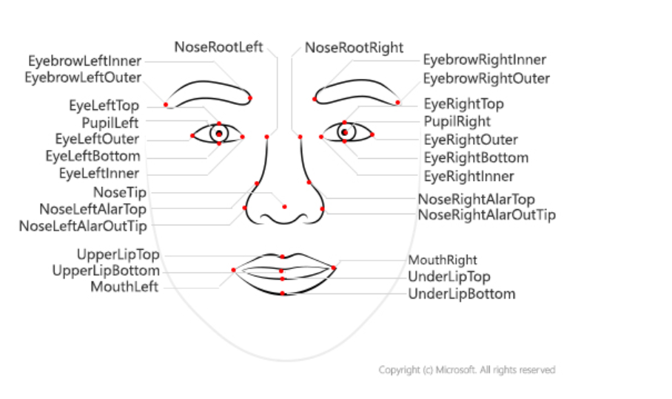
Vision| FACE API
Face Landmarks
.

Slide 38
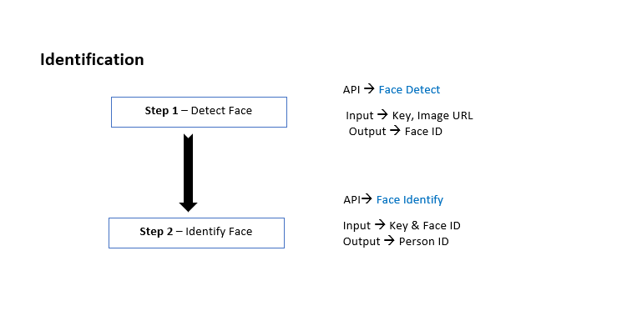
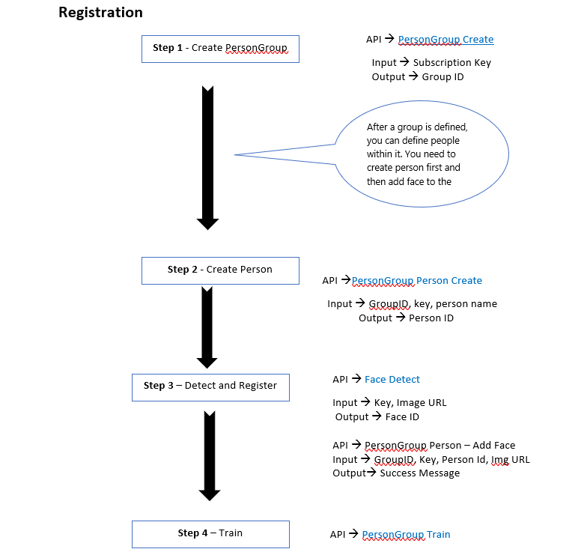

Slide 39
Vision| Face
Flow of APIs for Facial Verification / Recognition
Developer Portal
https://westcentralus.dev.cognitive.microsoft.com/docs/services/563879b61984550e40cbbe8d/operations/563879b61984550f30395237/console
.

Slide 40
Vision| Face API
.
DEMO
.

Slide 41
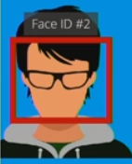
Vision| Face
Web API calls for 1 Person
Detect – Return a face ID
Identify – return a user ID
Get Person – return the user data
That’s 3 API call = 3 Transaction
.
Face#1
Web API calls for 3 Person
Detect – 1 API call , 1 transaction up to 64 faces
Identify – 1 API call , 1 transaction up to 10 faces
Get Person – 3 API calls , 3 transactions
That’s 5 API call = 5 Transaction
Offline face detection frameworks – Find a face before sending it to Cognitive Service
.
Face#1
Face#2
Face#3

Slide 42
Vision| FACE API
Image Requirements / Limitations / Challenges
.
Avoid Obstructions blocking one or both eyes – Hands Blocking Eyes or Wearing Sun Glasses
Avoid Harsh lighting – Flashing lights or Severe lights in the background
Extreme face angles (head pose) or face occlusion (objects such as sunglasses or hands that block part of the face) can affect detection. Frontal and near-frontal faces give the best results.
Avoid using very old photos for training.
Avoid extreme facial expression during Training… Like Laughing out Aloud or Screaming etc. PCA fails to handle extreme emotions in similar faces
Train the images formats of types PNG, JPG, GIF or BMP. Other formats are not allowed
Avoid uploading image files which are beyond 4 MB size. Max size for a Training image is 4 MB
The detectable face size range is 36x36 to 4096x4096 pixels. Faces out of this range will not be detected. Optimal Face Size to consider for Training is 200x200 pixels
Make sure face image used for training is having around 100 pixels between the two eyes

Slide 43
Vision| FACE API
Building Blocks
.
Device Validation: Device Infra requirements validation – Camera Pixel Size, OS Minimum Version as per the Face Recognition Guidelines
Object Filtering: Removal of Objects that reduces the Accuracy of Face Detection – Removal of Flashy Lights in the back-ground, Removal of Sun Glasses, Avoiding Images with Darkness
Image Validation : Validates the Image with respect to FACE Recognition Guidelines – Face Availability, Face Visibility, More number of Faces, Face Image Guidelines ( Min Pixel, Max Pixel, Optimal Pixes, Pixel Distance Between Eyes), Face Angle and Head Orientation
Fake / Real Image Detection : One of the biggest Security problem with Facial recognition systems is to identify whether the “Face” being used for registration / verification is for real or fake. We do not have any APIs or Model to check Real Vs Fake. WE have build our own model to identify “Real Vs Fake” and see the demo for the same - Link
Additional Layer of Liveliness Detection using Gestures : It is always a best practice to ask the user to show some gestures before verification just to make sure liveliness of the user is always checked. Generally gestures like “Smile”, “Eye Blinking”
Are used to check the liveliness of the user.

Slide 44
Vision| Face API
Use Cases
.
Facial Recognition Based Attendance Systems
Facial Recognition Based Access Control System
Tesla car company in electric-car market, showed-off an SUV that’s hoping to sell in 2019 that unlocks the door when its facial recognition software recognizes the driver.
Safety in Cars - A Face enabled system monitors eye blinking, facial expressions and head movements. If any signs are obtained of the driver being drowsy or inattentive, the biometric system sends some visual or audible alerts to get back the driver’s attention.
Airlines(JetBlue) have already started using face recognition to help people check bags, check into flights and board planes faster. Passengers will step up to a camera, and the kiosk will compare the facial scan to passport photos in the U.S. customs database to confirm the match.
A variety of phones including the latest iPhone X, OnePlus 5T are now using face recognition to unlock phones.
Retail Crime - Face recognition is currently being used to instantly identify when known shoplifters, organized retail criminals or people with a history of fraud enter retail establishments. Photographs of individuals can be matched against large databases of criminals so that loss prevention and retail security professionals can be instantly notified

Slide 45
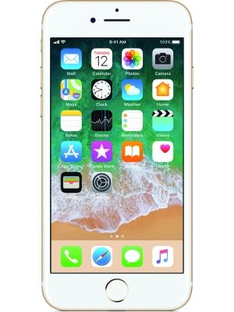
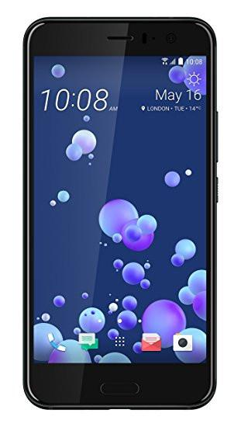
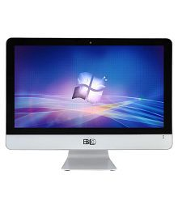


Device Validation
No
Show Notification to User & Retry
Channels
Yes
Image Validation
No
Show Notification to User & Retry
Yes
Object Filtering
No
Show Notification to User & Retry
Face Captured
Yes
Fake or Real Image Checking ?
Yes
No
Liveliness Detection Using Gesture
Show the Gesture
Show Notification to User & Retry
Yes
Registration / Verification Done Successfully
Valid Gesture ?
Show Notification to
User to follow Gesture
No

Slide 46
Vision| Video Indexer
Azure Video Indexer is a cloud application built on Azure Media Analytics, Azure Search, Cognitive Services (such as the Face API, Microsoft Translator, the Computer Vision API, and Custom Speech Service). It enables you to extract the insights from your videos using Video Indexer
.

Slide 47
Vision| Video Indexer
APIs Request / Response
.

Slide 48
Vision| Video Indexer
Demos
.

Slide 49
Vision| Video Indexer
Use Cases
.
Fining out moments from a Video where a particular person talking particular keywords. Such searches are required for news agencies, educational institutions , broad-casters and entertainment content owners
For example creating “Highlights” video from match recording video
Creating “Trailer Ad Videos”
Monetization – Video Indexer can help improve the value of videos. As an example, industries that rely on ad revenue (for example, news media, social media, etc.), can deliver more relevant ads by using the extracted insights as additional signals to the ad server (presenting a sports shoe ad is more relevant in the middle of a football match vs. a swimming competition)
User engagement – Video insights can be used to improve user engagement by positioning the relevant video moments to users. As an example, consider an educational video that explains spheres for the first 30 minutes and pyramids in the next 30 minutes. A student reading about pyramids would benefit more if the video is positioned starting from the 30-minute marker.

Slide 50
Vision| Form Recognizer(Preview)
Azure Form Recognizer is a cognitive service that uses machine learning technology to identify and extract key-value pairs and table data from form documents. It then outputs structured data that includes the relationships in the original file. You can call your custom Form Recognizer model using a simple REST API in order to reduce complexity and easily integrate it into your workflow or application.

Slide 51
Vision| Form Recognizer(Preview)
APIs Request / Response
.

Slide 52
Vision| Form Recognizer(Preview)
Demos
.

Slide 53
Vision| Form Recognizer(Preview)
Image Requirements / Limitations / Challenges
.
Form Recognizer works on input documents that meet the following requirements:
JPG, PNG, or PDF format (text or scanned). Text embedded PDFs are preferable because there is no possibility of error in character extraction and location.
File size must be less than 4 megabytes (MB)
For images, dimensions must be between 50x50 and 4200x4200 pixels
If scanned from paper documents, forms should be high-quality scans
Must use the Latin alphabet (English characters)
Printed data (not handwritten)
Must contain keys and values
Keys can appear above or to the left of the values, but not below or to the right.
Additionally, Form Recognizer does not yet support the following types of input data:
Complex tables (nested tables, merged headers or cells, and so on)
Checkboxes or radio buttons
PDF documents longer than 50 pages

Slide 54
Vision| Form Recognizer(Preview)
Use Cases
.
All use-cases fall around “Robotic Process Automation” which automates extraction of data from forms and move it the back end LOB system for further analysis.
This laborious, time-consuming, and error-prone process is generally handled by a bunch of SMEs.
With Form Recognizer, now SMEs can spend more time on higher-value activities and the whole process of Extracting data and integrating the same with any LoB applications can be done very easily and effectively using Form Recognizers

Slide 55
Day 1 closure and Q&A

Slide 56
AI| Knowledge mining Using Azure Search
.
Knowledge Mining is the process of discovering actionable information from large sets of unstructured data , like text and images. It uses AI to detect hidden patterns and information.
Azure Search
AI-powered cloud search service for web and mobile app development
Enterprise Search as a Service - Azure PaaS Product
Enrich and Extract insights through cognitive skills( Cognitive Search)
Natural Language Processing for Web search grade experience
Creates indexed metadata about your data

Slide 57
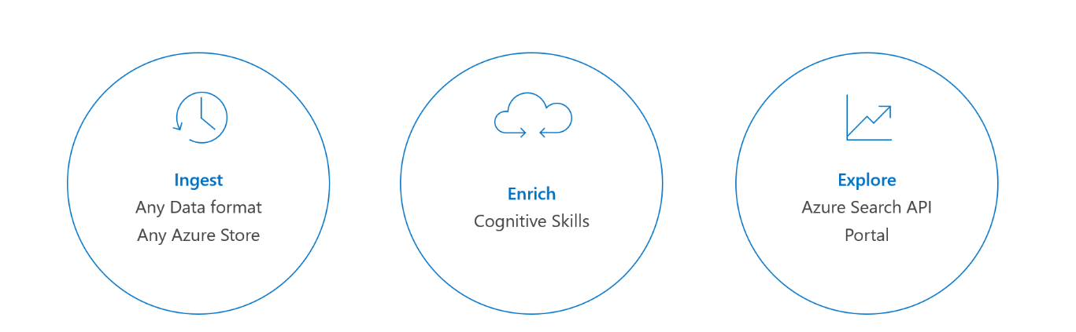
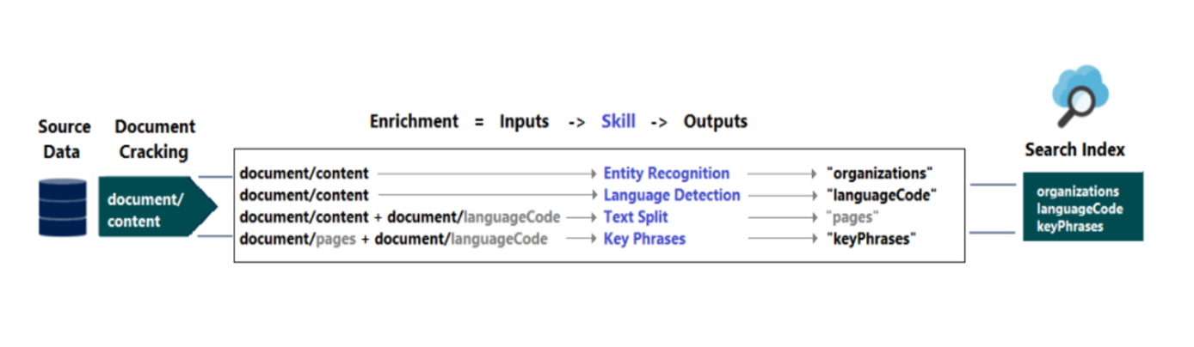
AI| How it Works
.

Slide 58
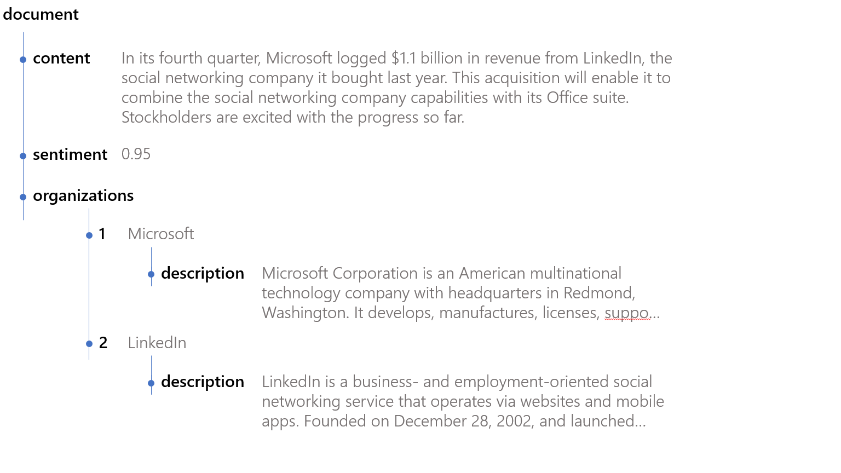
"In its fourth quarter, Microsoft logged $1.1 billion in revenue from LinkedIn, the social networking company it bought last year. The acquisition enables Microsoft to combine LinkedIn capabilities with its CRM and Office capabilities. Stockholders are excited with the progress so far."
A likely outcome would be a generated structure similar to the following illustration:
"In its fourth quarter, Microsoft logged $1.1 billion in revenue from LinkedIn, the social networking company it bought last year. The acquisition enables Microsoft to combine LinkedIn capabilities with its CRM and Office capabilities. Stockholders are excited with the progress so far.“
A likely outcome would be a generated structure similar to the following illustration:

Slide 59
AI| Knowledge mining Using Azure Search
.
File Formats:
Microsoft Office
PDF
HTML
XML, JSON
ZIP
EML, RTE, TXT
JPEG,PNG,JPG
CSV
Data Source:
Azure SQL
Text Column
JSON/XML columns
SQL Server laaS on Azure
Cosmos DB
MySql(PaaS and laaS)
Azure Files

Slide 60
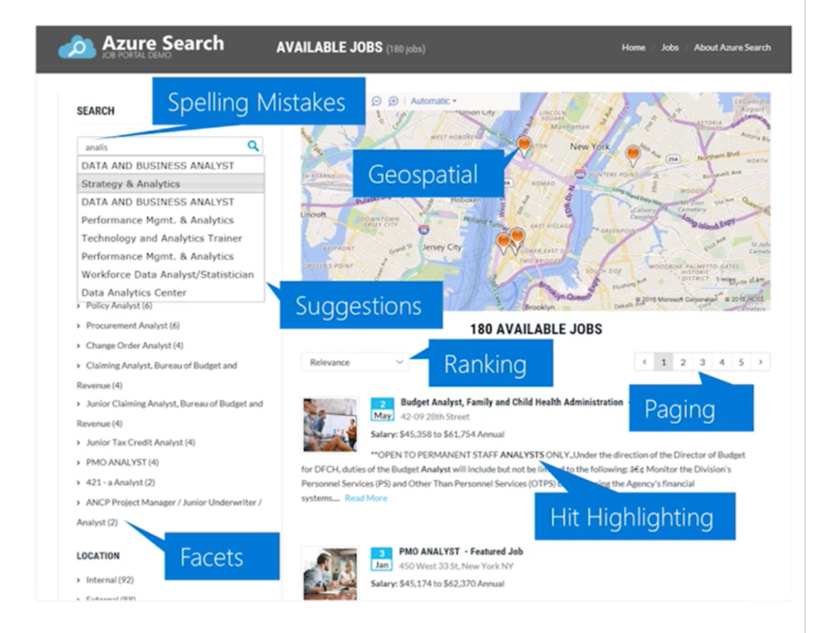
AI| Knowledge mining Using Azure Search
.
Type Ahead Search
Faceting Search
Geospatial Search
Synonym based Search
Custom Analyzer(50+ Languages)

Slide 61
AI| Components/ Services required
.
STEP 1 - Storage Account
Create the Azure Blob service and upload the dataset
STEP 2 - Cognitive Service Account
STEP 3 - Azure Search Account
STEP 4 – Setup the Skillset

Slide 62
Azure Search
Demos
.

Slide 63
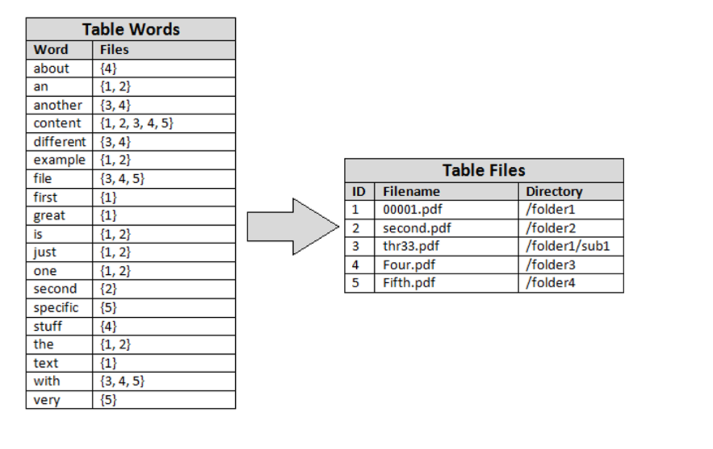
AI| Inverted Index
.

Slide 64
Speech| Speech Services
Enabling Ears to your app or service. Convert spoken language into text or produce natural sounding speech from text using standard (or customizable) voice fonts.
Speech to Text – Converts spoken audio to text for intuitive interaction
https://azure.microsoft.com/en-in/services/cognitive-services/speech-to-text/
2. Text to Speech – Give natural voice to your apps
https://azure.microsoft.com/en-in/services/cognitive-services/text-to-speech/
3. Speech Translation

Slide 65
Speech| Speech Services
Demos
.

Slide 66
Speech| Speaker Recognition
1. Speech Verification – Use your voice for verification. The API can be used to power applications with an intelligent verification tool. If the speaker claims to be of a certain identity use voice to verify this claim.
2. Speaker Identification –Identifies who is speaking. The API can be used to determine the identity of an unknown speaker. Input audio of the unknown speaker is paired against a group of selected speakers, and in the case there is a match found, the speaker’s identity is returned.
https://azure.microsoft.com/en-in/services/cognitive-services/speaker-recognition/

Slide 67
Speech| Speaker Identification
Flow of APIs
Create Identification Profile
Create Identification Enrollment
Speaker Identification
https://westus.dev.cognitive.microsoft.com/docs/services/563309b6778daf02acc0a508/operations/5645c3271984551c84ec6797
.

Slide 68
Speech| Speaker Verification
Flow of APIs
Create Verification Profile
Create Verification Enrollment
Enrollment can happen only with predefined phrases. This list can be seen by calling the API Verification Phrases
For Verification, we need to do Enrollment of the same Phrase for 3 times with states - Enrolling, Training, Enrolled
3. Speaker Verification
https://westus.dev.cognitive.microsoft.com/docs/services/563309b6778daf02acc0a508/operations/5645c3271984551c84ec6797
.

Slide 69
Speech| Speaker Recognition
Demos
.

Slide 70
Speech|Usecases
Use Cases
.
Building Voice Command Based Applications
Generating Conversation Transcript
Call center Log Analytics and Scoring of DSAT , CSAT

Slide 71
Speech
Audio Requirements / Limitations / Challenges
.
Audio Files for Speaker Verification and Identification should meeting the following requirements
Use this as Step Up Authentication and not as the Primary Authentication Mechanism.
Container | WAV
Encoding | PCM
Rate | 16K
Sample Format | 16 bit
Channels | Mono

Slide 72
Language| QnA Maker
Create an FAQ service from existing content
.
Knowledge Base out of semi-structured content like FAQ documents, URLs, and product manuals and answers natural language questions by matching it with the best possible answer from the QnA’s in your Knowledge base.
https://www.qnamaker.ai

Slide 73
Language | LUIS
Language Understanding (LUIS) is a cloud-based API service that applies custom machine-learning intelligence to a user's conversational, natural language text to predict overall meaning, and pull out relevant, detailed information.
A LUIS app contains a domain-specific natural language model. You can start the LUIS app with a prebuilt domain model, build your own model, or blend pieces of a prebuilt domain with your own custom information.
Prebuilt model LUIS has many prebuilt domain models including intents, utterances, and prebuilt entities. Prebuilt domain models include the entire design for you and are a great way to start using LUIS quickly.
Custom Entities LUIS gives you several ways to identify your own custom intents and entities including machine-learned entities, specific or literal entities, and a combination of machine-learned and literal.
.

Slide 74
Language | LUIS
Concepts in LUIS
Utterances are the Inputs from the user which app needs to interpret.
2. Intents User Intention
3. Entities Extracts data from the utterance. LUIS offers different types of entities for different types of data.
.

Slide 75
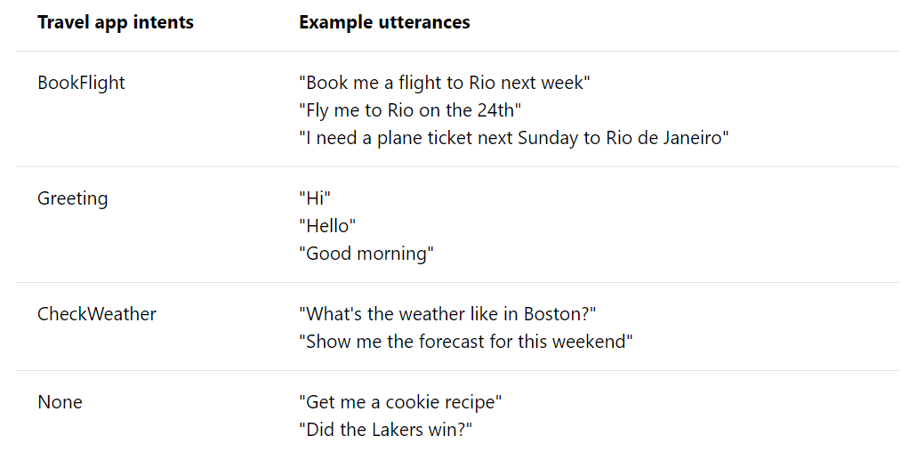
Language| LUIS
Concepts in LUIS
.
Intent : An intent represents a task or action the user wants to perform. It is a purpose or goal expressed in a user's utterance.

Slide 76
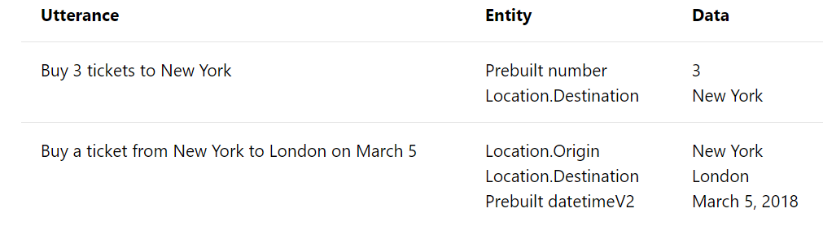
Language| LUIS
Concepts in LUIS
.
Entity : Entity represents a word or phrase inside the utterance. Represents a class including a collection of similar objects (places, things, people, events or concepts). Describes information relevant to the intent

Slide 77
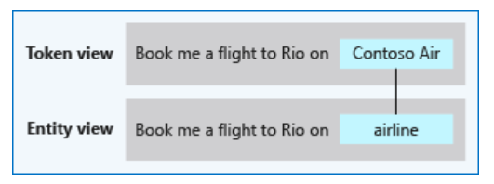
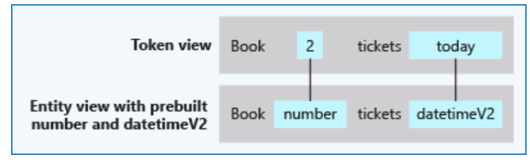
Language| LUIS
Concepts in LUIS
.
Types of Entities :
Simple entity : A simple entity is a generic entity that describes a single concept and is learned from the machine-learned context. Because simple entities are generally names such as company names, product names, or other categories of names
Prebuilt entity : Prebuilt entities are built-in types that represent common concepts such as email, URL
and phone number

Slide 78
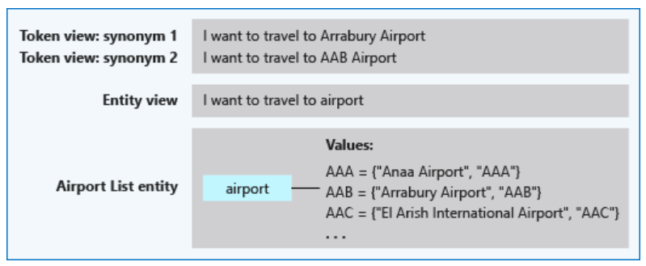
Language| LUIS
.
List entity : List Entity is used when your data has related words or synonyms.
The entity is a good fit when the text data:
Are a known set
The text in the utterance is an exact match with a synonym. LUIS doesn't use the list beyond exact text matches. Stemming, plurals, and other variations are not resolved with a list entity. To manage variations, consider using a pattern with the optional text syntax.

Slide 79
Language| LUIS
.
Pattern.Any :Pattern.any is a variable-length placeholder used only in a pattern's template utterance to mark where the entity begins and ends.
I have completed {TaskDetails} today
I have completed Abc Module Development, integration with LoB1 and unit testing today
I have completed Abc Module coding which took more than 3 hours of my time today
I have completed Parcel A Delivery today
The entity is a good fit when the text data:
The ending of the entity can be confused with the remaining text of the utterance

Slide 80
Language| LUIS
.
Regular expression : Regular Expression Entity is used to pull out wel - formatted data.
If you are working with any Human Resources app and you need to pull out data based on HRF no’s then you can use this Entity.
For Example ,
I would like to view the status of hrf-13450
When is hrf-76543 got updated?
Format used here is hrf-[0-9]{5}

Slide 81
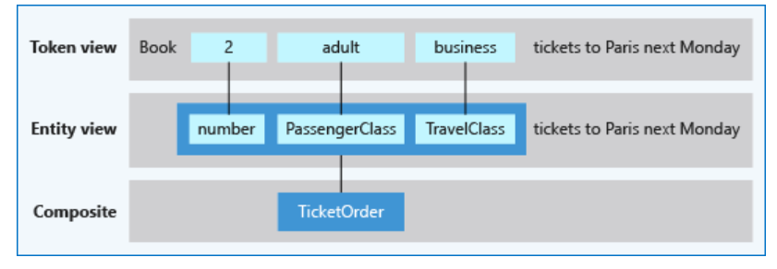
Language| LUIS
Composite Entity : A composite entity is made up of other entities, such as prebuilt entities, simple, regular
expression, and list entities. The separate entities form a whole entity. This entity is a good fit when the data -
Are related to each other | Need to be grouped and processed by the client application as a unit of information.

Slide 82
Language| LUIS
Building LUIS Model
https://www.luis.ai
.

Slide 83
Language| LUIS
Benefits
Add natural language understanding to your apps
Quickly build a custom language solution
Always learning and improving
Enterprise-ready, available worldwide
.

Slide 84
Language| LUIS
Best Practices
Define distinct intents – ( Book a flight, book a hotel)
Find a sweet spot between too generic and too specific for each intent ( MakePayment, MakePaymentwithCouponValue)
Build your app iteratively ( 3 Datasets – Training, Testing and Review)
Don't add many example utterances to intents
Don't add many example utterances of the same format, ignoring other formats
Add phrase lists and patterns in later iterations
Balance your utterances across all intents except the None intent.
Don't mix the definition of intents and entities
Monitor the performance of your app
.

Slide 85
Language | Text Analytics
The Text Analytics API is a cloud-based service that provides advanced natural language processing over raw text, and includes four main functions: sentiment analysis, key phrase extraction, language detection, and entity recognition.
Sentiment Analysis - Sentiment Analysis tells whether the given phrase is positive or Negative. The Api returns values between 0 to 1 . If the value is close to 1 it indicates the phrase is positive, if it close to 0 it indicate the phrase is negative.
Key Phrase Extraction - Helps you in identifying all Key words available in the phrase. the document is bigger. Document size must be under 5,120 characters per document, and you. This works better when can have up to 1,000 items (IDs) per collection.
Language Detection- You can detect which language the input text is written in and report a single language code for every document submitted on the request for up to 120 languages.
NER(Named Entity Recognition) is the ability of Text Analytics which identifies the Entities available in the phrase
.

Slide 86
Language| Text Analytics
API Request and Response
https://azure.microsoft.com/en-in/services/cognitive-services/text-analytics/
Demos
.

Slide 87
Language| Text Analytics
Use Cases
.
Product / Any Entity Text Based Feedback Sentiments
Building out Data Pipelines that automatically extracts data from multiple sources
Building out Knowledge Mining Use cases

Slide 88
Language| Content Moderation
The Azure Content Moderator API is a cognitive service that checks text, image, and video content for material that is potentially offensive, risky, or otherwise undesirable. When such material is found, the service applies appropriate labels (flags) to the content
Text Moderation- Scans text for offensive content, sexually explicit or suggestive content, profanity, and personal data.
Image Moderation - Scans images for adult or racy content, detects text in images with the Optical Character Recognition (OCR) capability, and detects faces.
Video Moderation - Scans videos for adult or racy content and returns time markers for said content.
.

Slide 89
Language| Content Moderation
Use Cases
.
Online marketplaces that moderate product catalogs and other user-generated content
Gaming companies that moderate user-generated game artifacts and chat rooms
Social messaging platforms that moderate images, text, and videos added by their users
Enterprise media companies that implement centralized moderation for their content

Slide 90
Cognitive Services | Decision Making – Anomaly Detection
The Anomaly Detector API enables you to monitor and detect abnormalities in your time series data with machine learning. The Anomaly Detector API adapts by automatically identifying and applying the best-fitting models to your data, regardless of industry, scenario, or data volume
Batch detection- To detect anomalies throughout a batch of data points over a given time range, use the following request URI with your time series data:
/timeseries/entire/detect.
Streaming detection- To continuously detect anomalies on streaming data, use the following request URI with your latest data point:
/timeseries/last/detect.
.

Slide 91
Cognitive Services | Decision Making – Anomaly Detection - Demo
.

Slide 92
Cognitive Services | Decision Making – Anomaly Detection
Use Cases
.
Outlier Detection in any Industry segments

Slide 93
Cognitive Services | Decision Making – Personalizer
Azure Personalizer is a cloud-based API service that allows you to choose the best experience to show to your users, learning from their real-time behavior.
Client Application provides list o Actions and along Context (User / Device / Both)
Personalizer chooses the best action to take and responds bac the client application
Client Application takes that action and updates personalizer back with feedback inters of reward points
Personalizer updates its model based on the feedback to set it more accurate to next action prediction
.

Slide 94
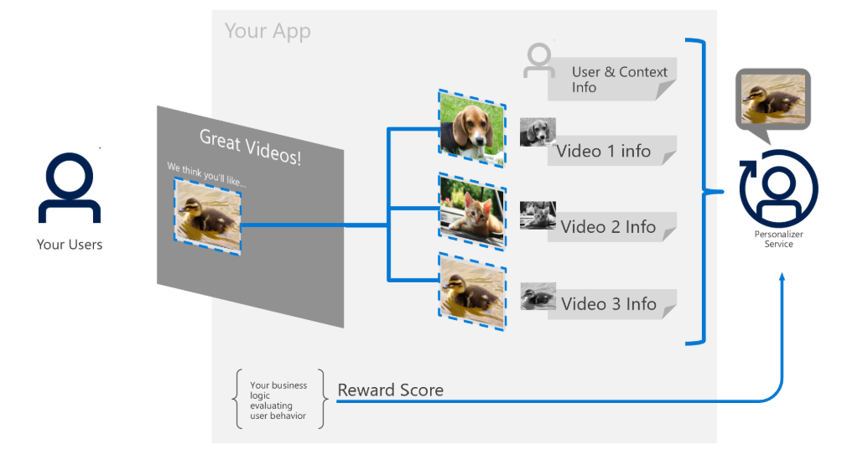
Cognitive Services | Decision Making – Personalizer
Azure Personalizer is a cloud-based API service that allows you to choose the best experience to show to your users, learning from their real-time behavior.
.

Slide 95
Cognitive Services | Decision Making – Personalizer
Demo & Use-cases
.
Production Recommendations In Retail Apps
Video Recommendations in Learning Apps
Reinforcement learning use cases across industries

Slide 96
Day 2 closure and Q&A

Slide 97
Conversational Commerce
Azure Bot Service

Slide 98

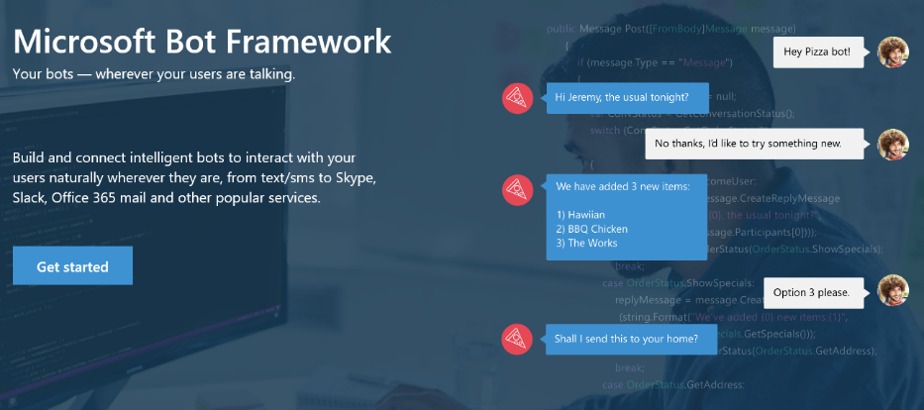
Your bots – wherever your users converse
Your Bots – where your users converse
Intelligence
Cognitive Services
Bot Framework
Cortana
Bot Connector Service: A service to register your bot, configure channels and publish to the Bot Directory. Connect your bot(s) seamlessly to text/sms, Office 365 mail, Skype, Slack, Twitter, and more.
Bot Builder SDK: An open source SDK hosted on GitHub. Everything you need to build great dialogs within your Node.js or C# bot
Bot Directory: A public directory of bots registered through the Bot Connector Service. Discover, try, and add bots to conversation experiences
Notes:
Microsoft Bot Framework enables organizations to build intelligent agents (Bots) that allow your intelligent systems to interact with your users in more contextual and natural ways, from text/sms to Office365 mail to Skype, Slack and other services. The Bot Framework provides developers with a developer portal & SDK to build your bot, a bot connector service to connect to social channels such as Twitter, Slack etc. and a bot directory to discover and use existing bots.
T: Next, Cortana.

Slide 99
Bot Framework ( Conversational Commerce )
Intelligence
Introduction
Azure Bot Service
Bot Builder
Cognitive Services
App Economy to Bot Economy
Basic
Introduction + SDKs
Bot Framework
Conversational Commerce
Form
Bot Simulator
Cortana
About Azure Bot Framework
LUIS
Bot Connectors
Industry Case Studies
Proactive
Bot Framework Portal
Q&A

Slide 100
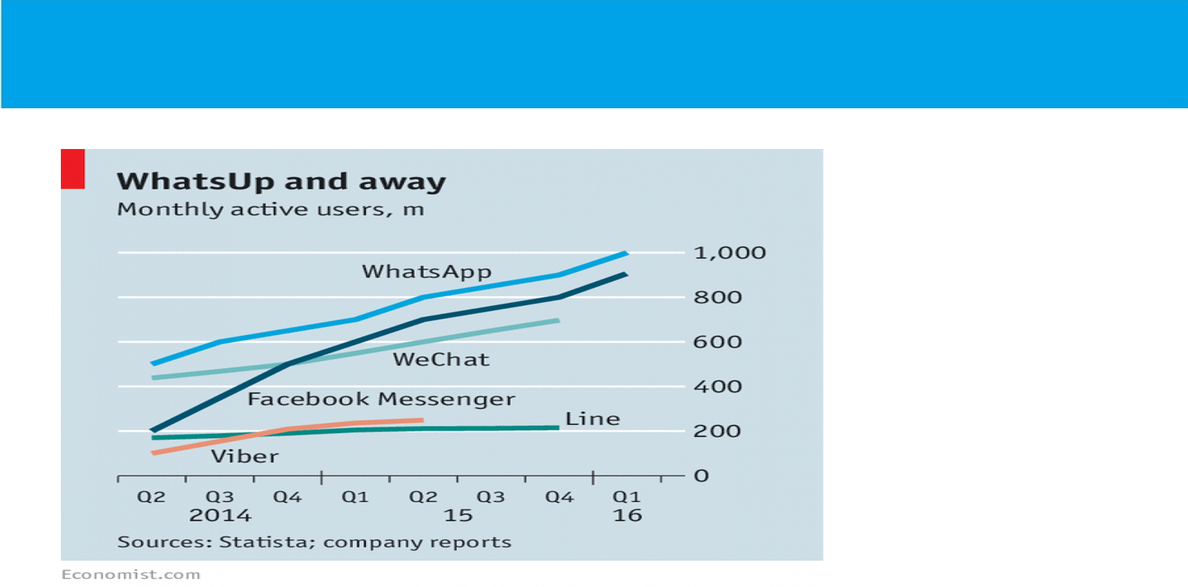

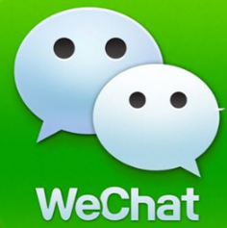


App Economy to Bot Economy

Slide 101
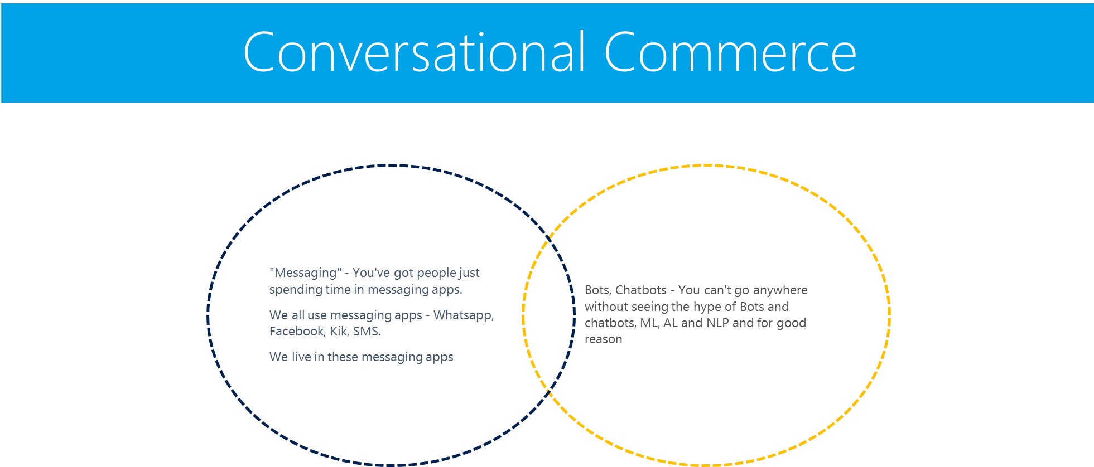

Slide 102

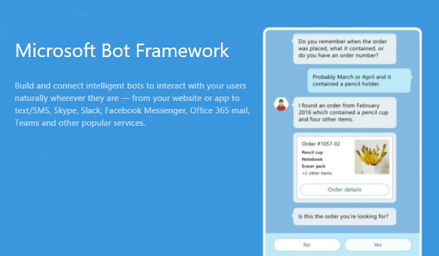
Notes:
About Bot Framework
The Bot Framework is a platform for building, connecting, testing, and deploying powerful and intelligent bots. You can quickly start building bots with the Azure Bot Service. If you prefer building a bot from scratch, the Bot Framework provides the Bot Builder SDK for .NET and Node.js.
Let's look at an example of a bot that schedules salon appointments. The bot understands the user's intent, presents appointment options using action buttons, displays the user's selection when they tap an appointment, and then sends a thumbnail card that contains the appointment's specifics.

Slide 103
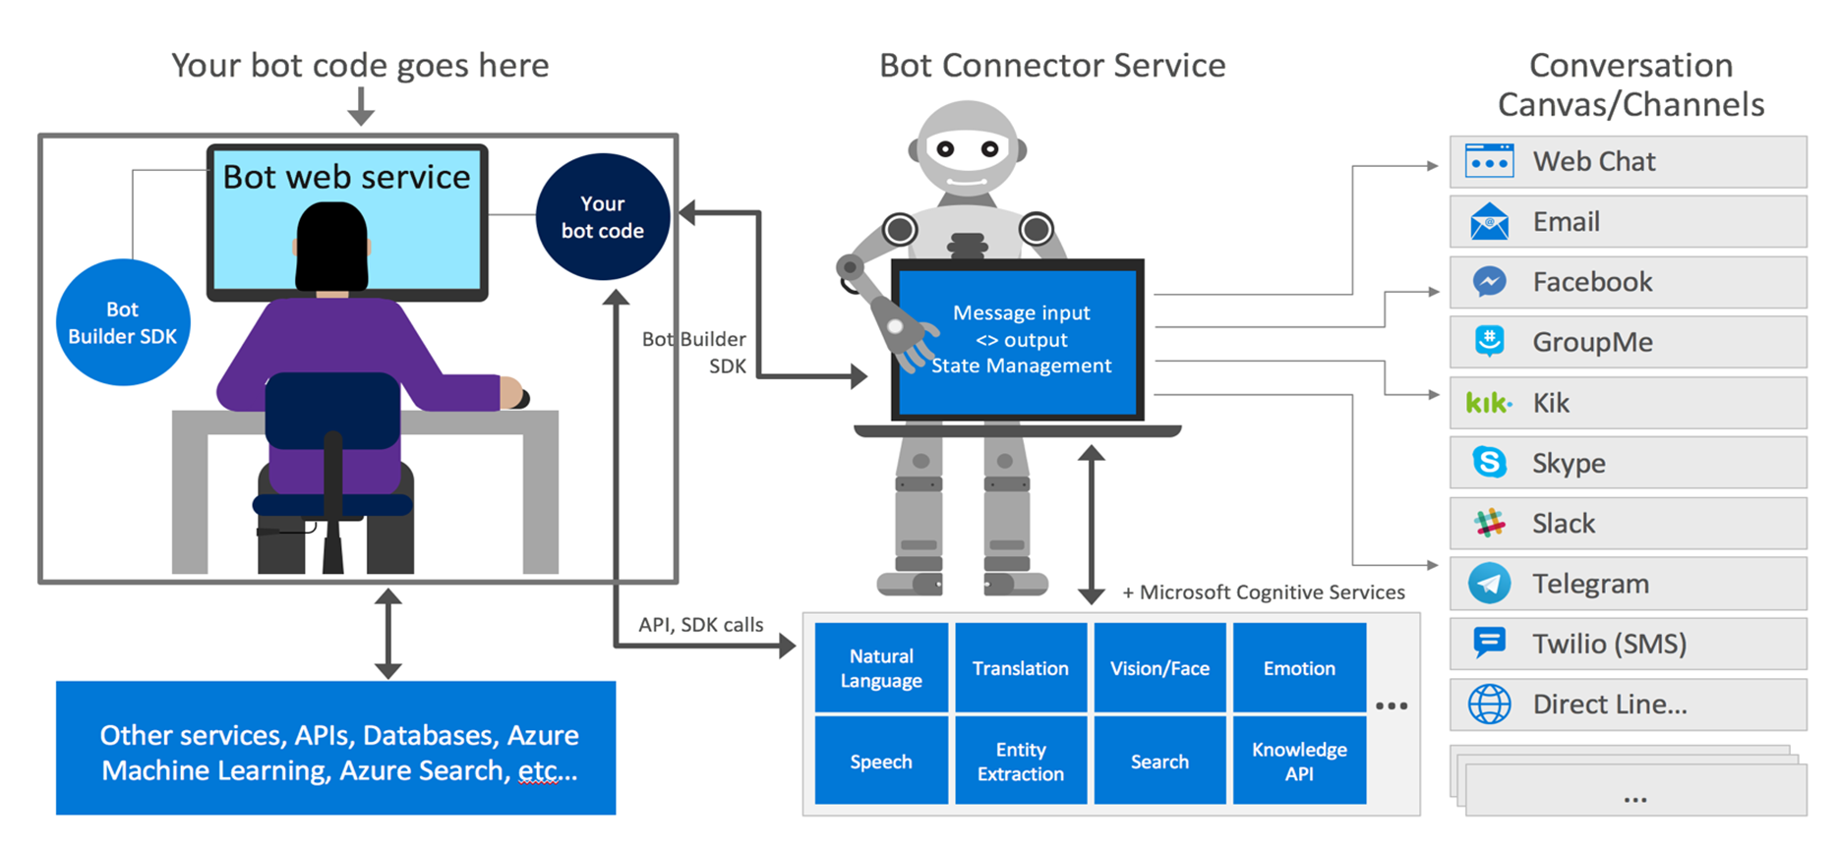
Bot Frame Work Components

Slide 104
Chat Bots| Demos/ Code Walk Thro / HoLs
.
Basic Bot
Waterfall Bot
Form Based Bot
QnA Bot
LUIS Bot

Slide 105
Chat Bots| Key Bot Scenarios
.
Cortana skills bot
Enterprise productivity bot
Information bot
IoT bot

Slide 106
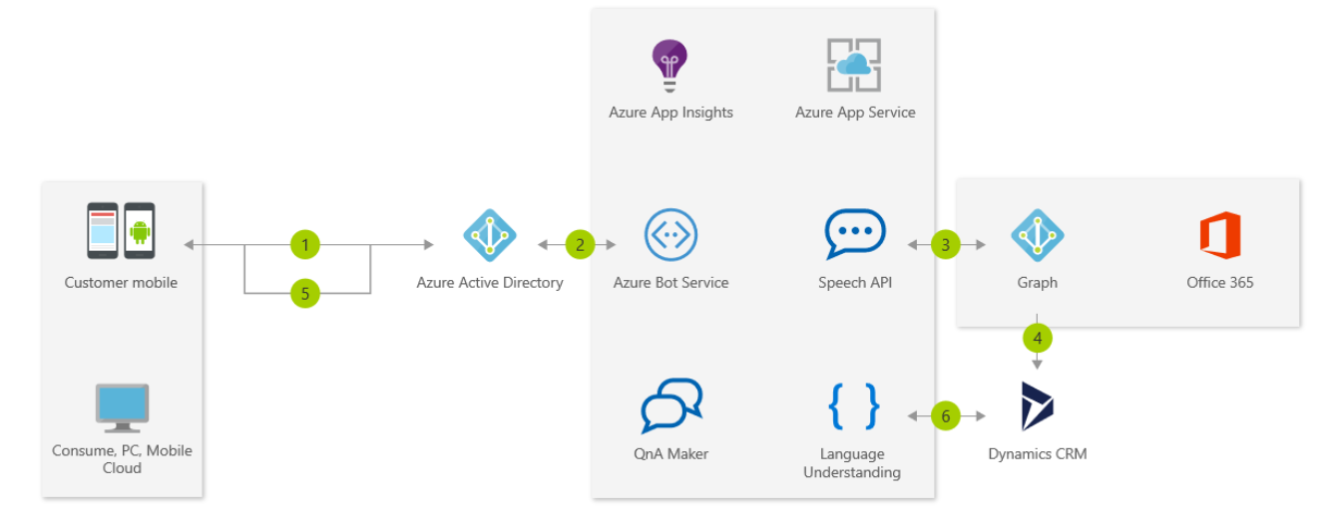
Chat Bots| Enterprise productivity bot
These bots increase productivity of any organization by integrating bots with productivity services like Office 365 and Dynamics CRM and any of their proprietary LoB Applications
.

Slide 107
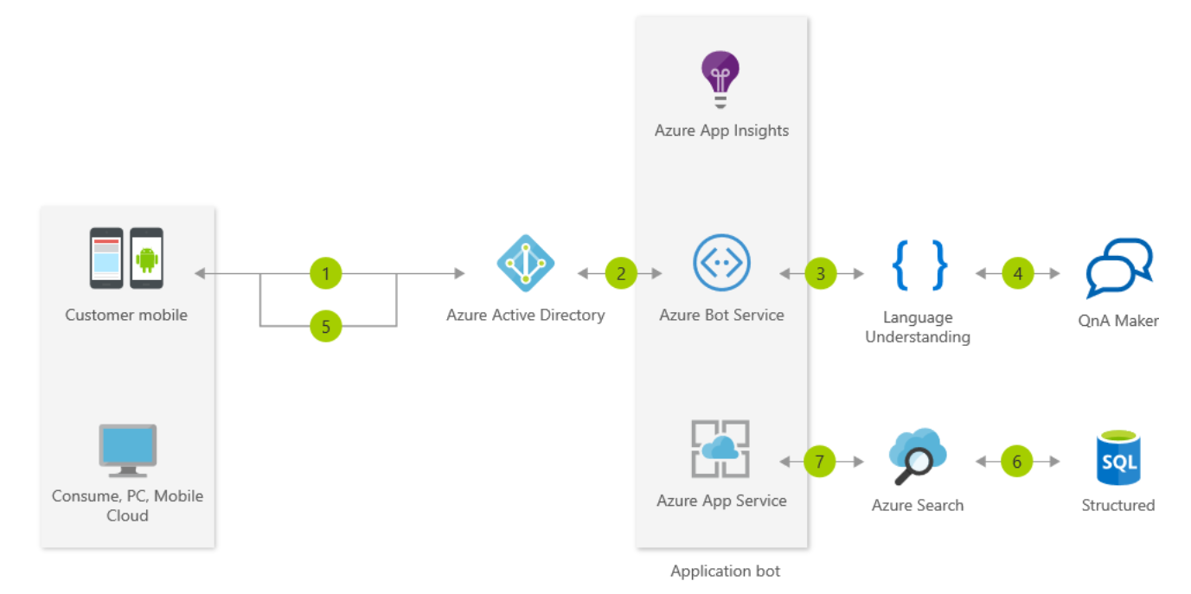
Chat Bots| Information bot
May be the one you've heard the most about. There are lots of use-cases for a bot like this, including: FAQ, IT support, store location and information, open-ended search, retail/inventory...the list goes on. An information bot could be used to answer questions defined in a knowledge set or even more open-ended questions
.

Slide 108
Chat Bots| Common Bot Working Patterns
.
Task automation
Bot enables a user to complete a specific task or set of tasks without any assistance from a human. This type of bot often closely resembles a typical app or website, communicating with the user primarily via rich user controls and text. It may have natural language understanding capabilities to enrich conversations with users.
Examples : How to Reset my Password
Access to knowledge and other content ( Knowledge Mining)
Designed to provide information about virtually any topic. For example, one knowledge bot might answer questions about events such as, "What bot events are there at this conference?", "When is the next show?", or "Who is Tame Impala?" Another might answer IT-related questions such as "How do I update my operating system?" or "Where do I go to reset my password?" Yet another might answer questions about contacts such as "Who is John Doe?" or "What is Jane Doe's email address?
Bot to human handoff
Regardless of how much artificial intelligence a bot possesses, there may still be times when it needs to hand off the conversation to a human being. The bot should recognize when it needs to hand off and provide the user with a clear, smooth transition.

Slide 109
Chat Bots| Common Bot Working Patterns
.
Bot to web browser and back
Transitioning from chat to web browser and back is not ideal, as switching between applications can easily confuse a user. To provide a better experience, many channels offer built-in HTML windows that a bot can use to present applications would otherwise appear in a web browser. This technique allows the user to remain within the conversation while still accessing external resources. This approach is conceptually similar to mobile applications managing authorization flows using OAuth within embedded web views
Two Main Scenarios : Authentication & Authorization, Security & Compliance ( Online Payment)
Communicating with rich text and media
Attachment: You may want to send the user content like an image or video
Hero card: Besides a simple attachment, you can attach a hero card, which allows you to combine images and buttons in one object.
Adaptive card: Adaptive cards make it easier for you to build for one channel and deploy to many, matching the theme of the destination.
Carousel of cards: Use these when you want to include multiple attachments in a carousel layout, which places the attachments side-by-side and allows the user to scroll across (like a carousel...).
Suggested actions: These are great and also known as "quick replies" that can be shown to the user for a single (specific) turn of the conversation, meaning that after the user makes a selection they cannot return and click an "older" suggestion. Suggested actions can be used to decrease the amount of typing for users, as well as to help guide users through a conversation.

Slide 110
Chat Bots| Common Bot Working Patterns
.
Handling Interruptions
You might think that users are good and follow your planned conversation flow with no issues. However, often this is not the case. People change their minds, and you want your bot to be able to manage that. It's important to think about how you want your bot to handle those situations. Since all bots are different, the specifics will depend on your scenario.
Demo

